Slide 1
Fake Review Detection For Hoteliers
Team – 5
Gaurav Soni
Pramod Poojar
Surendra K V
Abhishek B P

Slide 2
Introduction
There are thousands of reviews online, which makes it convenient for people to make decisions, but the amount of data makes it difficult to sort through. The real value of online reviews is in its content and the certainty that reviewer indeed received products or services prior to writing the review. Promotion or demotion of the products and services is one of the main reasons for deceptive reviews. At times, to create better ratings for the venue, hotel owners pay employees to fabricate false reviews. Alternatively, some reviewers write negative reviews for malicious reasons, like to distort the reputation of the business reviewed.
Individuals use online reviews to make decisions about available products and services. In recent years, businesses and the research community have shown a great amount of interest in the identification of fake online reviews. Applying accurate algorithms to detect fake online reviews can protect individuals from spam and misinformation.

Slide 3
Project Overview
Individuals use online reviews to make decisions about available products and services. In recent years, businesses and the research community have shown a great amount of interest in the identification of fake online reviews. Applying accurate algorithms to detect fake online reviews can protect individuals from spam and misinformation. We gathered filtered and unfiltered online reviews for several hotels from Kaggle dataset. We extracted part-of-speech features from the data set using Natural Language Processing Techniques, and built an artificial neural network model on the processed data.
Our aim from the project is to make use of natural language processing techniques and build a bag of words model for the detection of fake reviews for hoteliers. Also, we do the hyperparameter tuning to achieve better accuracy. And finally predict whether the review is fake or real and lay out the conclusion.

Slide 4
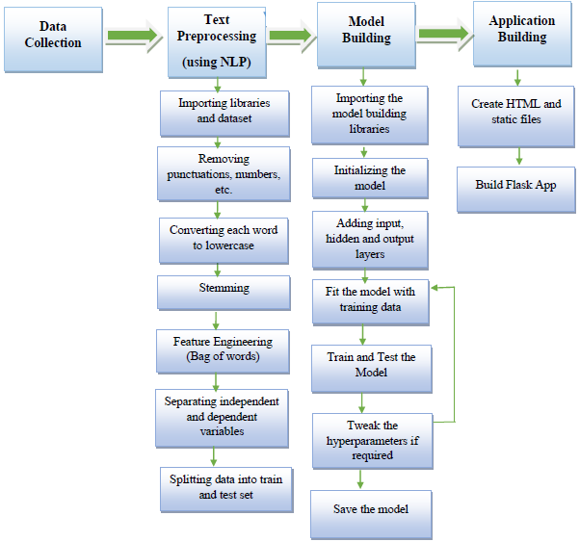
Block Diagram
Fig: Block Diagram
Fig: Block Diagram

Slide 5
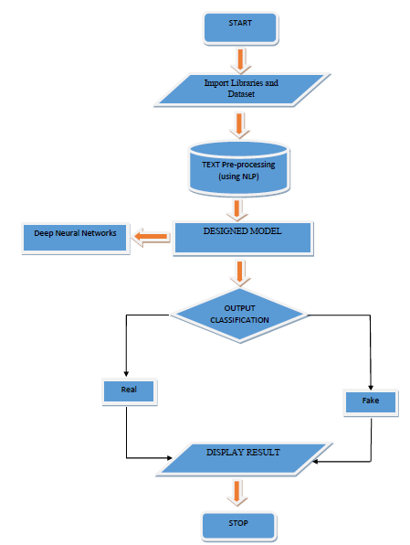
Fig: Flow Chart

Slide 6
Data Collection
In our project, we have used the deception opinion dataset. The data that is used in this project originally comes from the kaggle machine learning dataset. The data consists of over 1600 records from different hotels with truthful and deceptive reviews.
We use the following representation in the dataset :
deceptive – whether review is deceptive or truthful.
hotel – name of the hotel.
polarity – whether review is positive or negative (sentiments)
source – website from which review was taken
text – review written by customer

Slide 7
TEXT Pre-Processing
Text pre-processing is done using Natural Language Processing techniques. The required NLP modules are imported. Reviews in the dataset have punctuation marks, numbers, special symbols, etc. which are removed. Each word in every review is converted to lowercase.
Further, stemming is applied to all the reviews using Porter Stemmer. We need features for training our model and hence we apply feature engineering on the dataset. We extract around 2000 features from the reviews in the dataset and thus build a Bag of Words model. Then we separate independent and dependent variables. Finally, we divide the reviews dataset into 80% as training data and 20% as test data.

Slide 8
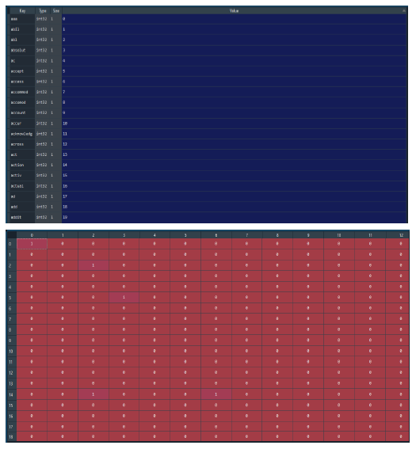
Fig: Bag of Words

Slide 9
Model Building
Model is built using the Deep Neural Networks. Required libraries are imported to build the model. A sequential keras model is initialized. Input, hidden and output layers are added to the neural network. The model is then trained using the training data. Its accuracy is improved by testing the model with test data and accordingly tuning the hyperparameters like batch size, epochs, number of neurons in hidden layers of the Deep Neural Network is done to further improve the accuracy. Model is evaluated using Confusion Matrix and Accuracy Score which ensures and establishes the validity of the model. Finally, the model is saved for using it while application building.

Slide 10
Application Building
HTML, CSS and Bootstrap are used to design a user-friendly interface to interact with the model built in last stage. The backend of the application is being handled by Flask framework. The inputs from the user are passed on to the flask back-end through POST request. In backend, this data from user is processed before feeding it to the model. The prediction done by the model is then sent back as a response for the POST request to the frontend. This result is displayed for the user which tells the user whether the review is classified as real or fake.

Slide 11
Advantages
Bag of Words is easy to implement and understand.
It operate in real-time due to low time complexity.
It is applicable in training and test-time.
This model is very intuitive and easy to explain to technical teams as well as to stakeholders.

Slide 12
Disadvantages
Bag of words doesn’t leverage co-occurrence statistics between words. In other words, it assumes all words are independent of each other.
It leads to a highly sparse vectors as there is nonzero value in dimensions corresponding to words that occur in the sentence.

Slide 13
Result
This projects consists of the details about the model which is used for the fake review detection for hoteliers. From the results, it is proven that the accuracy of the model has reached good level of 98.5%, if it is deployed in the real-time scenario then it will help many people in booking hotels without wasting the money on poor quality hotels. If the review is confirmed as fake by the model, then the person can avoid getting fooled and have a good travelling experience. It can be the best way of practice for people to save money and time for searching best hotels. As we know that the data plays a crucial role in every machine learning model, if the data is more specific and accurate about the truthfulness of the hotel review then that can help in reaching greater accuracy with better results in real-time applications.

Slide 14
THANK YOU
Team – 5
Gaurav Soni
Pramod Poojar
Surendra K V
Abhishek B P

